Slide 1


Scalability in Practice: a Highly scalable Website
SE124 (2022 Fall)
Yubin Xia / Xingda Wei
IPADS, Shanghai Jiao Tong University
https://www.sjtu.edu.cn

Slide 2




Scalable websites are everywhere
High request rate
100 billions of requests daily
Massive data
Facebook has more than 1 billion of images uploaded weekly, Baidu stores tens of billions of web pages

Slide 3
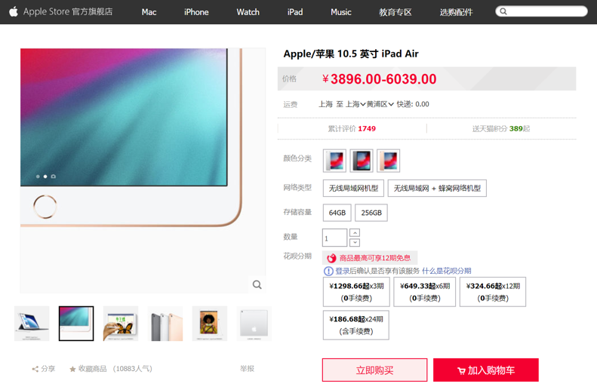
Different systems to support different types of data
Database
File system
Key-value store
一般用于存储哪些不是那么关心同步性的数据，因为单纯的使用KV存储会出现的问题
就是不同服务器可能更新并不同步

Slide 4

Each click needs thousands of servers to cooperate
Load Balance：
负载均衡，主要目的
将大量请求分配给多个
不同的server，降低单个
server的负载
Caching server
Caching server
…
Caching server
Caching
Caching
Caching
Distributed caching
distributed：分布式
Database server
Database server
CDN
Users
Application #1
generate the page
Database
user, price
…
Database
user, price
Application server
Distributed database
Internet
Load
Balance
Application #2
add the order
File server
File server
File server
File:
image
File:
image
…
File:
image
Application server
…
…
Message queue
Distributed file system

Slide 5
How to build Taobao on a single machine (in old days)?
Operating system:
Linux (in OS class)
Serving the requests: web server
Apache, Nginx (in ICS)
Serving the data: file system & DB
MySQL & inode file system (in CSE)
Displaying the page: HTML
PHP (in Web class)
LAMP = Linux + Apache + MySQL + PHP

Slide 6

Using one server to build Taobao
https://www.taobao.com
Internet
Application
generate the web page
File:
image
Database:
user, price
Server
Notes:
// todo: refine

Slide 7
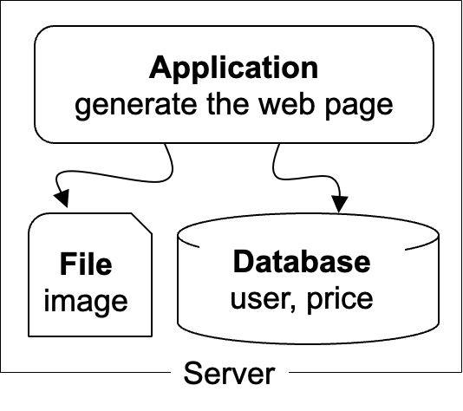
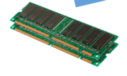
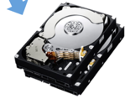
The architecture of LAMP cannot scale!
https://www.taobao.com
Internet
The disk & memory of one server cannot store massive amount of data
DRAM: 64 – 256 GB
HDD: 2 – 40 TB
Facebook has more than 1 billion of images uploaded weekly, Baidu stores tens of billions of web pages
File:
image
Database:
user, price
DRAM
HDD

Slide 8
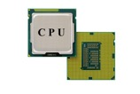
The architecture of LAMP cannot scale(n.规模,v.变化)!
https://www.taobao.com
Internet
Application uses the CPU for processing, while a single CPU can hardly scale due to the end of Moore’s law & Dennard scaling
Moore’s law: the number of transistors in a dense integrated circuit (IC) doubles about every two years.
Dennard scaling: as transistors get smaller, their power density stays constant
Application
generate the web page
当每一次更新的技术中晶体管的密度提升后，能耗保持不变

Slide 9

Step #1 for scalability: disaggregating application & data
disaggregate：分解
Scale
Application: handles application logic
Can be scaled with more CPUs
Database: requires reading/writing disk & cache
Can be scaled with faster disks & larger memory
File system: store large bulks of data
E.g., images, videos
Can be scaled with faster disks
Application
generate the web page
Application server
Local area network
File server
Database server
Scale
Scale
File:
image
Database
user, price
Database
user, price
Notes:
// TODO: add figure

Slide 10
Step #2 Avoid the slow data accesses? Caching
Observation: most requests are accessing a small portion of the data
Caching system with a single node:
E.g., page cache
Drawbacks: limited DRAM capacity
Distributed caching server
Benefits: huge DRAM capacity, e.g., deploy many caching servers
Application
generate the web page
Application server
Local area network
Caching server
Caching server
Caching
Caching
File server
Database server
分布式缓存：远程/local
File:
image
Database
user, price

Slide 11
Case study of distributed cache server: Memcached
Distributed caching server
Benefits: huge DRAM capacity
Memcached server
Store all the cached data in memory
Can scale out to use multiple servers
Memcached clients
Check whether server has cached data
On cache miss, fallback to database/file
Question:
How to find which server has cached the data?
Application
generate the web page
Net
Comm
Memached API
S0: 10.0.0.100
S1: 10.0.0.101
Routing
Application server
Local area network
(evict)
Caching server#0:
10.0.0.100
Caching server#1:
10.0.0.101
Caching
Memached
Caching
Memached

Slide 12
Step #3 for scalability: more servers
Internet
For stateless application servers
E.g., web servers
We can add more servers for scaling its performance
What is stateless?
The server only executes the logic that only relies on input data but no long-term state
Benefits:
Better fault-tolerance
Better elasticity(弹性)
Application
generate the web page
Application
generate the web page
Application
generate the web page
Application server #N
Application server #N
Application server #N
Local area network
Caching server
Caching server
Caching
Caching
File server
Database server
File:
image
Database
user, price

Slide 13
Step #3 for scalability: How to do the load balance?
Load balance: how to route the user quests to the application servers?
Leverage the network layer
use HTTP redirection,
use reverse proxy,
…
Load balance algorithms
round-robin
random
hashing
…
Internet
Load balancer
Application
generate the web page
Application
generate the web page
Application
generate the web page
Application server #N
Application server #N
Application server #N

Slide 14
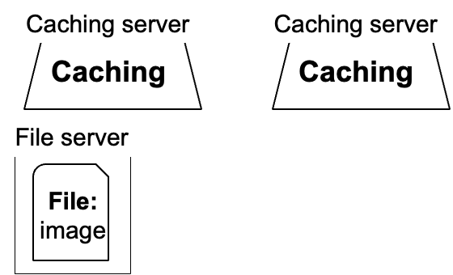
Step #4 for scalability: scaling database
#1. Separate the database for read/write(读写分离)
E.g., use primary-backup replication
The primary servers the writes and backup only serves reads
#2. Separate a single table on multiple databases(分页分表->不利于数据一致性)
E.g., a bank has reported that a single table has 100,000,000 rows
However, split a table on multiple machines makes consistency management more complex
Application
generate the web page
Application
generate the web page
Application
generate the web page
Application server #N
Application server #N
Application server #N
Local area network
Write
Read
Database server
Database server
Database
user, price
Database
user, price

Slide 15
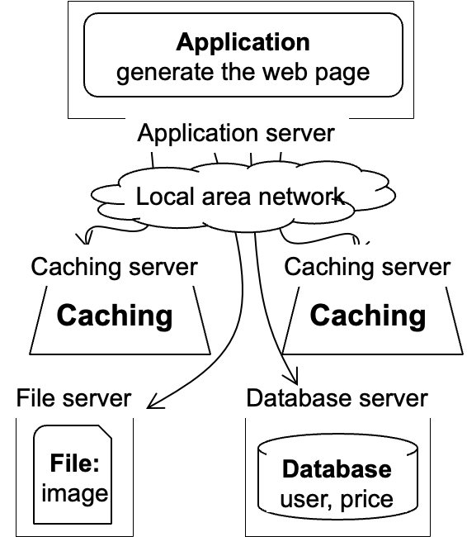
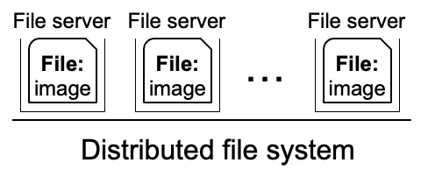
Step #5 for scalability: using distributed file system
Using multiple database in principle makes the database distributed
We can use a similar approach to make the file system distributed !
Well-known distributed file system
NFS (Network file system)
GFS (Google file system)
HDFS
Application
generate the web page
Application server
Local area network

Slide 16
Step #6 for scalability: using CDN
Goal: return the results to user as soon as possible
Why? Amazon has reported that 100ms latency increase will cause 1% financial loss
Core idea: caching (again)
E.g., CDN (content delivery network) caches the content at the network providers, which is closer to users(remote caching)
Challenge: how to do it without users’ awareness?
CDN
Users
Application
generate the web page
Internet
Application server
…

Slide 17


Step #7 for scalability: separate different applications
Use dedicated servers for different applications
Application #1
Alipay
Internet
Application server
Application #2
Taobao
Application server

Slide 18
How different applications communicate? MQ or DB
Message queue (MQ): applications send the message the queue, and the queue can buffer the message (somewhere between RPC and database)
E.g., Apache Kafka
Or, applications can directly use the databases, caching (e.g. KV) or file system to communicate with shared data
Internet
Application #1
Alipay
Application #2
Taobao
Application server
Application server
Local area network
Caching server
Message queue
Caching
Database server
File server
Database
user, price
File:
image

Slide 19


How to handle complex requests?
Example: after the website becoming larger, handling requests is far more than displaying a (static) web page
Alipay (支付宝)
E.g., fraud detection
Taobao
Hot list (热榜)
Dynamic product ads (千人千面)
Recommendation (you might also like)
…
Hot lists
Customized ads

Slide 20
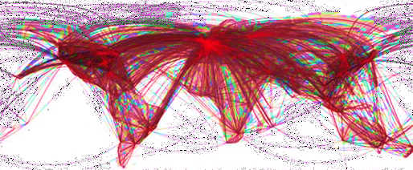

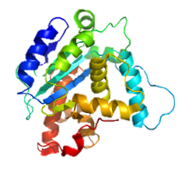
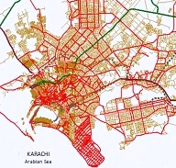
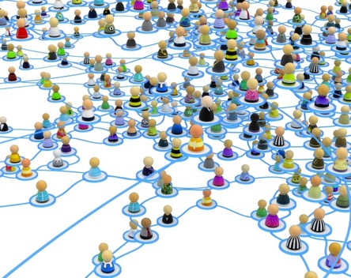


Use distributed computing frameworks for complex queries
General batch processing systems
MapReduce, Spark, etc.
Graph processing systems
GraphLab, Pregel, etc.
Machine learning systems
Tensorflow, pytorch, etc.

Slide 21
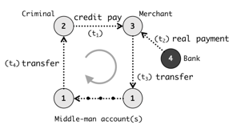

Step #7: separated applications + distributed computing
Example
Use general batch processing system to generate hot list
Use graph system to detect credit card fraud
Each framework is powered by massive machines
Alipay detects frauds w/ graph systems
Application #1
Alipay
Graph processing
e.g., GraphLab
Application server
Internet
Generate hot lists
Application #2
Taobao
Batch processing
e.g., MapReduce
Application server

Slide 22
Different applications may share some components
e.g., Alipay & Taobao may both communicate with the same DB
Alipay logic
Application #1
Alipay
Memached client
DB client
Internet
Application server
Application #2
Taobao
Taobao logic
Application server
Memached client
DB client

Slide 23
Different applications may share some components
e.g., Alipay & Taobao may both communicate with the same DB
Problem #1: disproportionate scaling
E.g., Alipay use more DB, while Taobao uses more Cache
Application #1
Alipay
Alipay logic
Internet
Application server
Memached client
DB client
Application #2
Taobao
Application server
Taobao logic
Memached client
DB client

Slide 24
Different applications may share some components
e.g., Alipay & Taobao may both communicate with the same DB
Problem #1: disproportionate scaling
Problem #2: redundant database connections
Taobao logic
Caching server
Memached client
DB client
Caching
N (applications) X M (servers)
Alipay logic
Database server
Memached client
DB client
Database
user, price

Slide 25

Step #8: Fine-grained distributed Services
Further decompose a webserver into a set of microservices(微服务)
Each can be scaled accordingly
在调用时就可以根据需要直接部署对应的
microservice
Alipay logic
Memached client
Internet
Taobao logic
DB client
Can be deployed on any server

Slide 26
Step #8: Fine-grained distributed Services
Further decompose a webserver into a set of microservices
Each can be scaled accordingly
Alipay logic
Memached client
Internet
Taobao logic
DB client

Slide 27
A scalable website: overall picture
We have not covered all the parts
E.g., container
Yet most of them are orthogonal to the scalability concepts in this class
Caching server
Caching server
Caching server
…
Caching
Caching
Caching
Distributed caching
Database server
Database server
CDN
Users
Application #1
generate the page
Database
user, price
…
Database
user, price
Application server
Distributed database
Internet
Load
Balance
Application #2
add the order
File server
File server
File server
File:
image
File:
image
…
File:
image
Application server
…
…
Message queue
Distributed file system

Slide 28
A scalable website: powered by distributed systems!
Distributed system: a collection of independent/autonomous connected through a communication network working together hosts to perform a service
Caching server
Caching server
Caching server
…
Caching
Caching
Caching
Distributed caching
Database server
Database server
CDN
Users
Application #1
generate the page
Database
user, price
…
Database
user, price
Application server
Distributed database
Internet
Load
Balance
Application #2
add the order
File server
File server
File server
File:
image
File:
image
…
File:
image
Application server
…
…
Message queue
Distributed file system

Slide 29
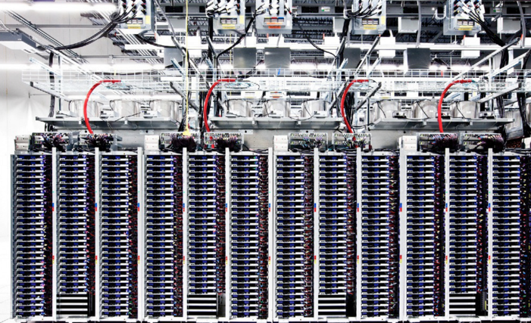
The underlying hardware: modern datacenters
Large server and storage farms
CPUs: > 20,000,000 cores
Disk capacity: > 1,000,000 GB
Caching server
Caching server
…
Caching server
Caching
Caching
Caching
Distributed caching
Database server
Database server
CDN
Users
Application #1
generate the page
Database
user, price
…
Database
user, price
Application server
Distributed database
Internet
Load
Balance
Application #2
add the order
File server
File server
File server
File:
image
File:
image
…
File:
image
Application server
…
…
Distributed file system

Slide 30

Datacenters that power the scalable website
Large-scale distributed systems: 10K – 100K servers
Each rack: 40 servers
Network: 10Gbps – 100Gbps in rack
10-100 MW of power
Source: “The Datacenter as a Computer --- An Introduction to the Design of Warehouse-Scale Machines”

Slide 31
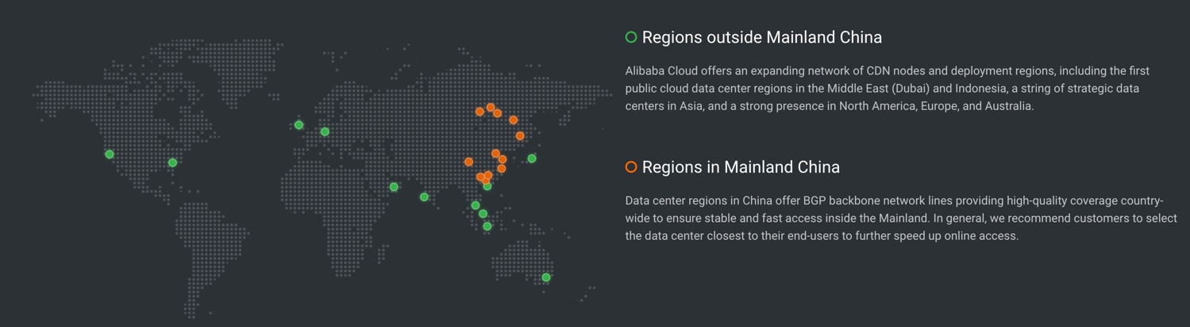
Geo-replicated datacenters
The locations of Alibaba datacenters
Source: https://www.alibabacloud.com/zh/global-locations

Slide 32
Design large-scale distributed system is challenging
Fault is common, how to handle it?

Slide 33

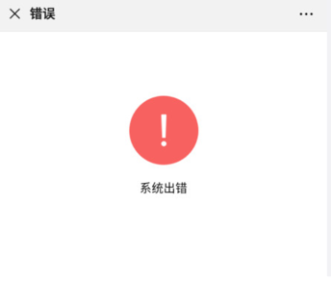
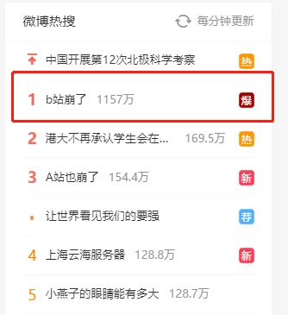


Notes:
宕机的例子，比如微信？

Slide 34
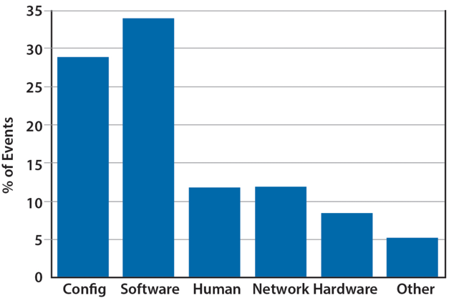


Faults are common
, especially in large distributed systems
Why faults are common especially in distributed systems? Scale!
“Suppose a cluster has ultra-reliable server nodes with a stellar mean time between failures (MTBF) of 30 years (10,000 days)—a cluster of 10,000 servers will see an average of one server failure per day. ”
Causes:
Operation error (human, configuration, etc.)
Software error (e.g., bug)
Hardware error
Power outage
Natural disaster
Source: The Datacenter as a Computer
-- An Introduction to the Design of Warehouse-Scale Machines

Slide 35
Faults and partial failures
On a single computer, it either works or it doesn’t
But in a distributed system, some parts of the system can be broken in some unpredictable way
Such failure is partial (aka., grey failure)
Since most other parts of the system are OK, we want the system still working!
Notes:
画一个big picture

Slide 36

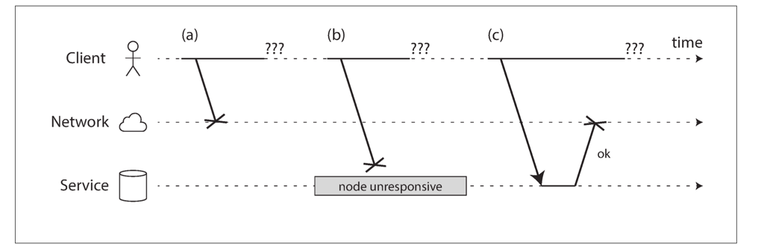
Faults and partial failures
Example: unreliable network
A client (e.g., Smartphone), sends requests to the service (e.g., Taobao), through network (5G, Wifi)
The client gets: “网络竟然崩溃了”, how can a network break?
Notes:
画一个big picture

Slide 37
Example: unreliable network
A user sends a request but the server does not reply, possible reasons:
1. The request may have been lost (e.g., someone unplugged a network cable).
2. The request may be waiting in a queue and will be delivered later (e.g., the network or the recipient is overloaded).
3. The remote node may have failed (e.g., it crashed or it was powered down).
4. The remote node may have temporarily stopped responding (e.g., it is experiencing a long garbage collection pause)
5. The remote node may have processed your request, but the response has been lost on the network (e.g., a network switch has been misconfigured).
6. The remote node may have processed your request, but the response has been delayed and will be delivered later (e.g., the network or your own machine is overloaded).
Notes:
+ 淘宝的联系

Slide 38
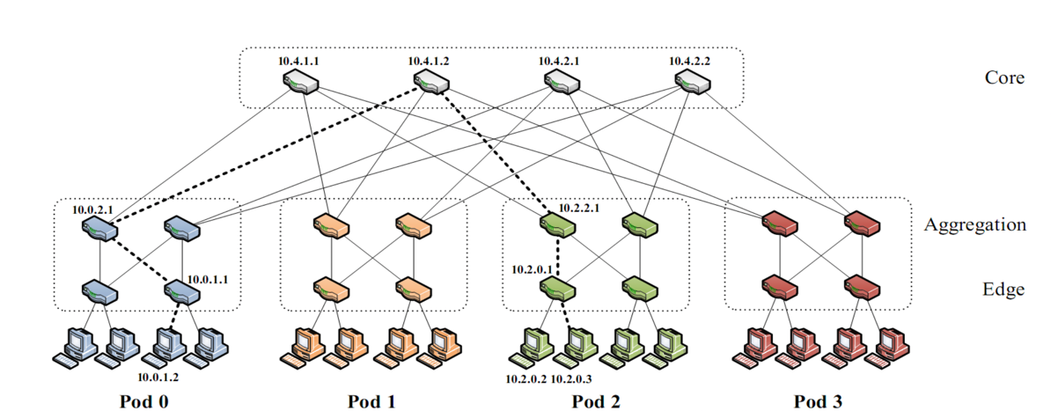
A common network fault: network partition
A network partition refers to network decomposition into relatively independent subnets — usually a real problem that cannot be ignored
Can happen when a switch is being upgraded in a datacenter
For example, suppose the datacenter adopts a fat-tree topology
Source: https://www.cs.cornell.edu/courses/cs5413/2017sp/lectures/16-datacenter-topologies2.pdf

Slide 39
A common network fault: network partition
A network partition refers to network decomposition into relatively independent subnets
Can happen when a switch is being upgraded in a datacenter
For example, suppose the datacenter adopts a fat-tree topology
Source: https://www.cs.cornell.edu/courses/cs5413/2017sp/lectures/16-datacenter-topologies2.pdf

Slide 40
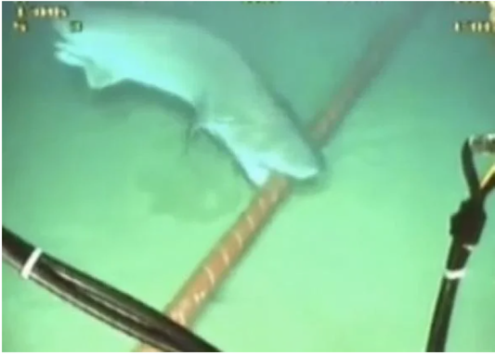
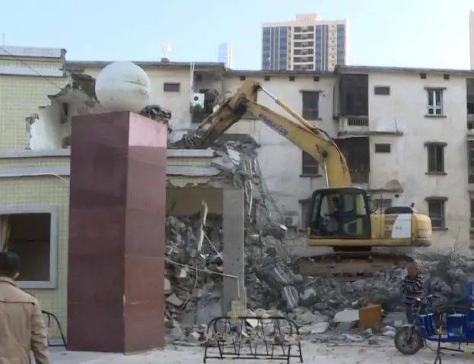
A common network fault: network partition
A network partition refers to network decomposition into relatively independent subnets
Can happen when a switch is being upgraded in a datacenter
Can even happen when being attacked by sharks
Source: https://slate.com/technology/2014/08/shark-attacks-threaten-google-s-undersea-internet-cables-video.html

Slide 41
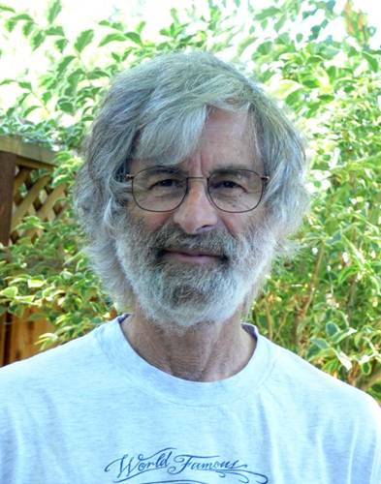
You know you have a distributed system when the crash of a computer you’ve never heard of stops you from getting any work done.
- Leslie Lamport
Lamport received the 2013 Turing Award for "fundamental contributions to the theory and practice of distributed and concurrent systems, notably the invention of concepts such as causality and logical clocks, safety and liveness, replicated state machines, and sequential consistency" in 2014.

Slide 42
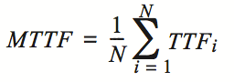
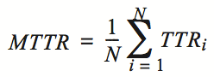
Availability(可用性,可用时间) and reliability(可靠性)
Availability: A measure of the time that a system was usable, as a fraction of the time that it was intended to be usable (x nines), corresponding downtime:
e.g. 3-nines -> 8 hour/year
e.g. 5-nines -> 5 min/year
e.g. 7-nines -> 3 sec/year
Metrics(指标) to measure reliability
MTTF: mean time to failure
MTTR: mean time to repair
MTBF: mean time between failure
MTBF = MTTF + MTTR

Slide 43




Large-scale systems can be highly available
Example#1: Internet, the BGP (Border Gateway Protocol) is highly available
Example#2: WeChat, Taobao & Baidu rarely (but not never) become outage

Slide 44
Achieving high availability: handling failures w/ replications
Replication
replicas: identical multiple copies(备份)
Example: replicated file servers
If one copy survives, the application is available
Application
generate the web page
Application server
Local area network
备份会提升server崩溃时系统的availability，
但是也会导致更新时数据不同步问题，
即consistency问题。
File server
File server
File server
File:
image
File:
image
File:
image
Identical copies

Slide 45
Challenge: consistency
Replication
replicas: identical multiple copies
Example: replicated file servers
If one copy survives, the application is available
Challenge: consistency
Application
generate the web page
Application server
Local area network
File server
File server
File server
File:
image
File:
image
File:
image

Slide 46
Challenge: consistency
Replication
replicas: identical multiple copies
Example: replicated file servers
If one copy survives, the application is available
Challenge: consistency
Application put file A to one server
Application
generate the web page
Application server
1
Local area network
File server
File server
File server
File:
image
File:
image
File:
image

Slide 47
Challenge: consistency
Replication
replicas: identical multiple copies
Example: replicated file servers
If one copy survives, the application is available
Challenge: consistency
Application put file A to one server
The server crashed
Application
generate the web page
Application server
Local area network
2
File server
File server
File server
File:
image
File:
image
File:
image

Slide 48
Challenge: consistency
Replication
replicas: identical multiple copies
Example: replicated file servers
If one copy survives, the application is available
Application put file A to one server
The server crashed
What happens when read A again?
Application
generate the web page
Application server
Local area network
3
File server
File server
File server
File:
image
File:
image
File:
image

Slide 49
The CAP theorem
Consistency, Availability & Partition tolerance

Slide 50
CAP: an example
Amazon has two zones: US and Euro
All US users connect to the US zone
All Euro users connect to the Euro zone
Define Availability and Consistency
C: all users see the actual number of items
Not-C: users see 1 item left, but actually is 0
A: all users can buy items at any time (if there are some)
Not-A: users might get "cannot buy now, please wait and retry"

Slide 51
The CAP theorem: 2 out of 3
It is impossible for a distributed computer system to simultaneously provide all three of the following guarantees
Consistency (all nodes see the same data at the same time)
Availability (a guarantee that every request receives a response about whether it succeeded or failed)
Partition tolerance (the system continues to operate despite arbitrary message loss or failure of part of the system)
v₀
v₀
v₀
v₀
v₁
v₀
v₁
v₀
v₁
v₀
S₁
S₂
S₁
S₂
S₁
S₂
S₁
S₂
S₁
S₂
S₁
S₂
A=v₁
done
A=?
1. A=v₀
C
C
C
C
C
C
2. Not available

Slide 52


Partition Tolerance
"P" is usually a reality
You can never count on the network connectivity
AP: sacrifice C
If you have one book but sell it to two customers
Maybe just an apology and a small gift coupon
CP: sacrifice A
If you are selling train ticket but cannot deliver
Customer may sue you
But the user can fail to buy the ticket, e.g., 12306 during spring festival in the last few years

Slide 53
CAP: not a Binary Decision
Example: a CP system does not mean no "A" at all during network partition
If the Euro zone and US zone are disconnected, the US zone can still keep available
Only the Euro zone is not available
When the network connects again, apply US zone data to Euro zone for consistency
要注意如选择了CP，并不是说就一定完全放弃了availibility，因为系统是分布式
的，可能存在部分正常的情况。AP同理。

Slide 54
Summary of the (ideal) properties of distributed systems
Can our system handle a larger workload?
Scalability
How easy the developer
can use our system?
How fast is our system?
Ease of programming
Performance
Consistency
Fault tolerance
Is our data/computation
correct?
What if some component crash?

Slide 55
Summary of the (ideal) properties of distributed systems
Sharding
Replication
Load balancing
New hardware
Scalability
Ease of programming
Performance
DSM, RPC, MapReduce, …
Caching
Consistency
Fault tolerance
Sequential, eventual,
consensus, isolation, etc.
High availability: replication
Durability: atomicity, logging, etc.

Slide 56
Summary of the (ideal) properties of distributed systems
These properties typically cannot achieve at the same time
The adults want them all, but the reality forces them to make trade-offs
Remote Procedure Call (RPC)
Distributed Shared Memory (DSM)
Scalability
Scalability
Ease of
programming
Performance
Ease of
programming
Performance
Consistency
Fault tolerance
Consistency
Fault tolerance
NoSQL databases
NewSQL databases (e.g., Spanner)
Scalability
Scalability
Ease of
programming
Performance
Ease of
programming
Performance
Consistency
Fault tolerance
Consistency
Fault tolerance

